Slide 1
Digital Design:
An Embedded Systems Approach Using Verilog
Chapter 6
Implementation Fabrics
Portions of this work are from the book, Digital Design: An Embedded Systems Approach Using Verilog, by Peter J. Ashenden, published by Morgan Kaufmann Publishers, Copyright 2007 Elsevier Inc. All rights reserved.

Slide 2
Integrated Circuits
Early digital circuits
  Relays, vacuum tubes, discrete transistors
Integrated circuits (ICs, or “chips”)
  Manufacture of multiple transistors and connections on surface of silicon wafer
  Invented in 1958: Jack Kilby at Texas Instruments (TI)
  Rapid growth since then, and ongoing

Slide 3
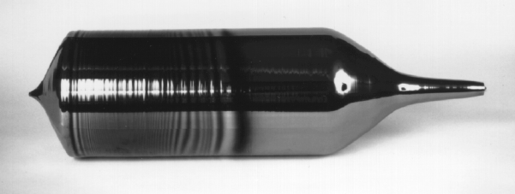
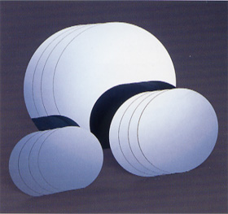
IC Manufacture: Wafers
Start with ingot of pure silicon
Saw into wafers & polish
  Early wafers: 50mm
  Now 300mm

Slide 4
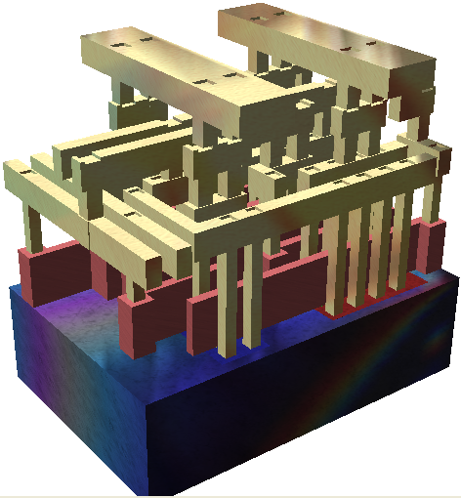
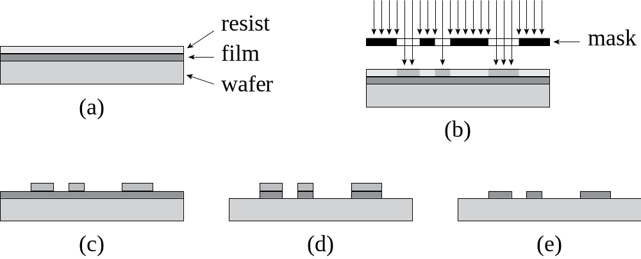
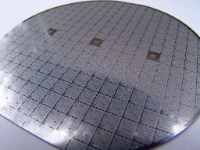
IC manufacture: Processing
Chemical processing steps based on photolithography
  Ion implantation
  Etching a deposited film
    SiO₂, polysilicon, metal

Slide 5
IC Manufacture: Test & Packaging
Defects cause some ICs to fail
  Test to identify which ICs don’t work
  Discard them when wafer is broken into chips
    Their cost is amortized over working chips
  Yield depends (in part) on IC area
    Constrain area to reduce final IC cost
Working chips are packaged and tested further

Slide 6
Exponential Trends
Circuit size and complexity depends on minimum feature size
  Which depends on manufacturing process
    Mask resolution, wavelength of light
Process nodes (ITRS Roadmap)
  350nm (1995), 250nm (1998),
  180nm (2000), 130nm (2002),
  90nm (2004), 65nm (2007), 45nm (2010), 32nm (2013), 22nm (2016), 16nm (2019)
  Smaller feature size ⇒ denser, faster

Slide 7
SSI and MSI
In 1964, TI introduced 5400/7400 family of TTL ICs
  Other manufacturers followed, making 7400 family a de facto standard
  Small-scale integrated (SSI)
    7400: 4 × NAND gate 7427: 4 × NOR gate
    7474: 2 × D flip-flop …
  Medium-scale integrated (MSI)
    7490: 4-bit counter 7494: 4-bit shift reg
    …

Slide 8
Other Logic Families
Variations on electrical characteristics
  74L… : low power
  74S… : Schottky diodes ⇒ fast switching
  74LS… : compromise between speed and power
  74ALS… : advances low-power Schottky
  74F… : fast
CMOS families
  4000 family: very low power, 3–15V
  74HC…, 74AHC… : TTL compatible

Slide 9
Large Scale Integration
1970s: LSI (thousands of transistors)
  Small microprocessors became feasible
  Custom LSI chips for high-volume applications
SSI/MSI mainly used for glue logic
Later additions to 74xx… families oriented toward glue-logic and interfacing
  E.g., multibit tristate drivers, registers
  Other functions supplanted by PLDs

Slide 10
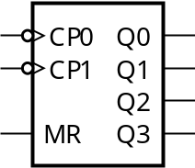
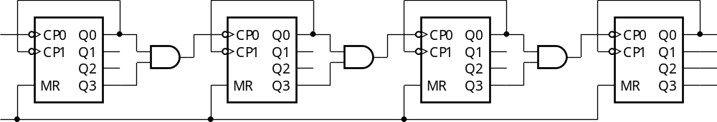
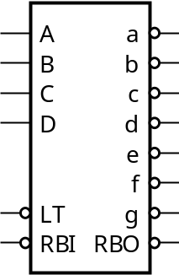
MSI Example: Counter/Display
74LS390: dual decade counter
74LS08 glue
74LS47: 7-segment decoder

Slide 11
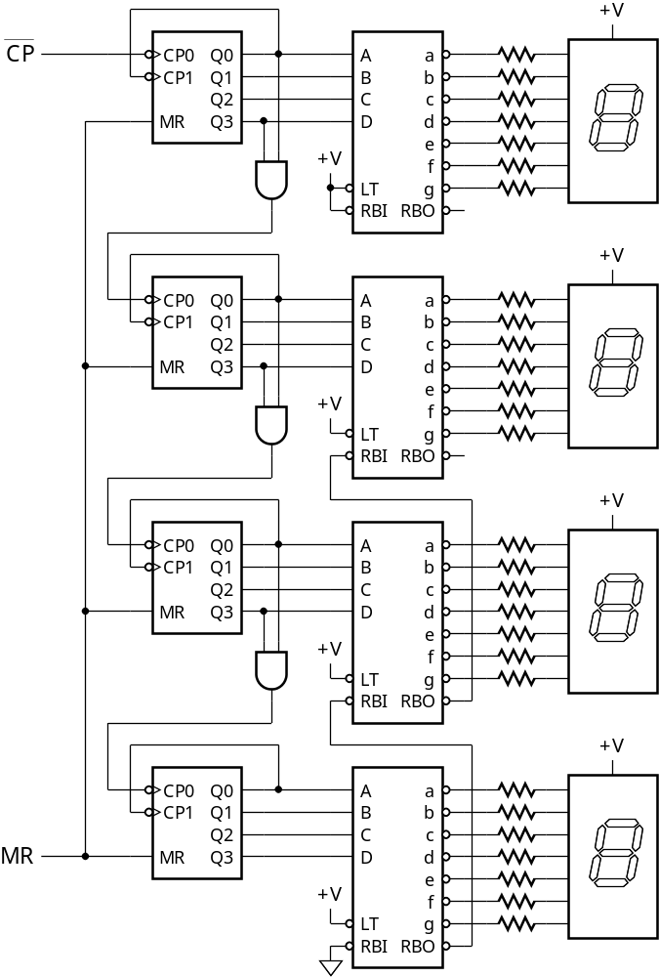
MSI Example: Counter/Display

Slide 12
VLSI and ASICs
1980s: Very Large Scale Integration
  Then ULSI, then what?
  VLSI now just means IC design
Application-specific ICs (ASICs)
  Enabled by CAD tools, foundry services
  Often designed for a range of related products in a market segment
    Application-specific standard products (ASSPs)
    E.g., cell phone ICs

Slide 13
ASIC Economics
ASIC has lower unit cost than an FPGA
  But more design/verification effort
  Higher non-recurring engineering (NRE) cost
    Amortized over production run
  ASICs make sense for high volumes
Full custom
  Design each transistor and wire
  High NRE, but best performance & least area
Standard cell
  Use basic components from a foundry’s library

Slide 14
Programmable Logic Devices (PLDs)
PLDs can be programmed after manufacture to vary their function
  C.f. fixed-function SSI/MSI ICs and ASICs
Higher unit cost than ASIC
  But lower NRE
  Ideal for low to medium product volumes

Slide 15
Programmable Array Logic (PALs)
Introduced by Monolithic Memories Inc in 1970s
  First widely-used PLDs
  Programmed by blowing fusible links in the circuit
    Use a special programming instrument
PAL16L8
  16 inputs, 8 active-low outputs
PAL16R8
  16 inputs, 8 registered outputs

Slide 16
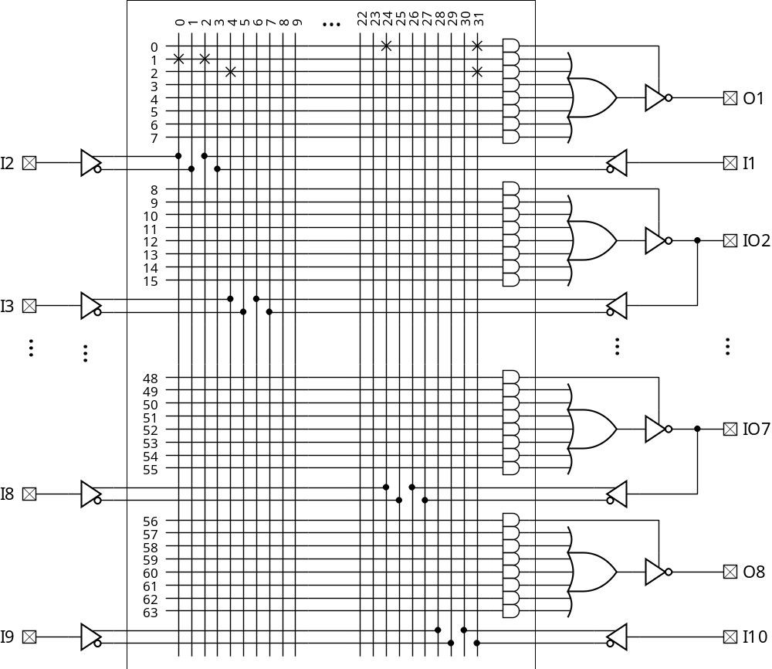
PAL16L8
I8 · I10
I1 · I2 + I3 · I10

Slide 17
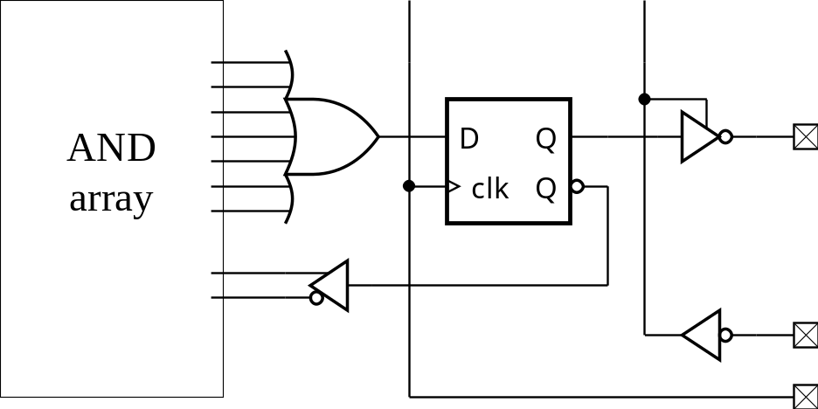
PAL16R8 Output Circuit
Feedback path is useful for implementing FSMs

Slide 18
Designing with PALs
Useful even for simple circuits
  Single package solution lowers cost
Describe function using Boolean equations
  In HDL, or simple language such as ABEL
  Synthesize to fuse map file used by programming instrument
  If design doesn’t fit
    Partition into multiple PALs or use a more complex PLD

Slide 19
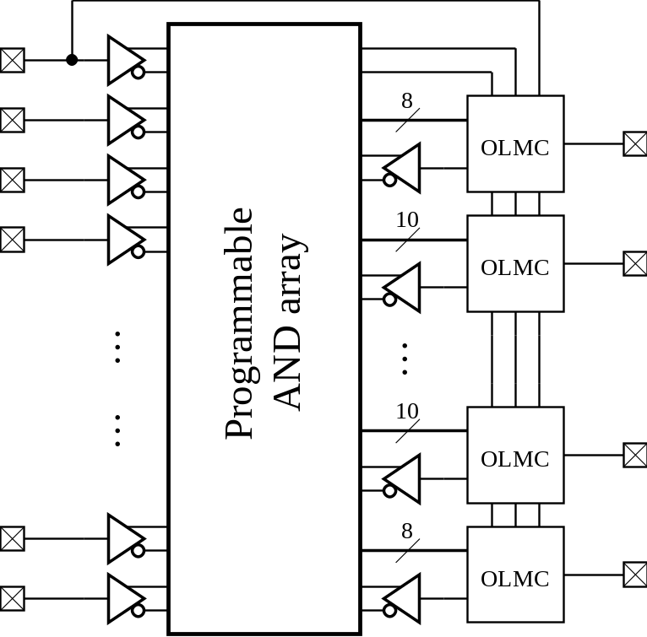
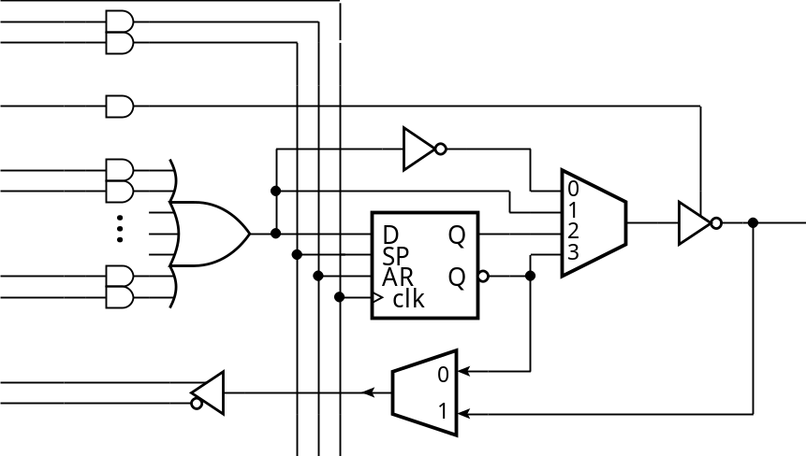
Generic Array Logic (GALs)
Programmable Output Logic Macrocells (OLMCs)
  Use EEPROM technology
  E.g., GAL22V10

Slide 20
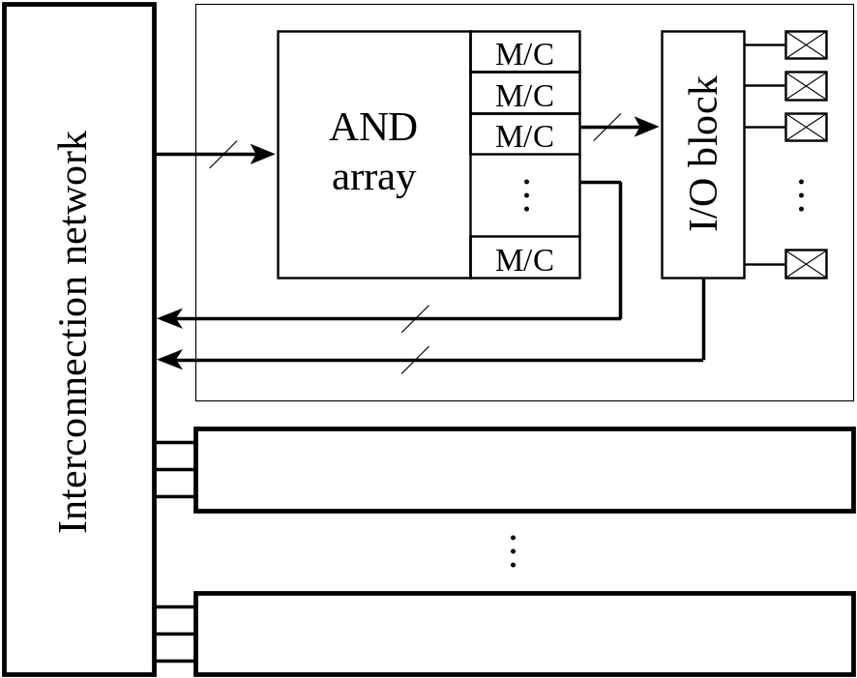
Complex PLDs (CPLDs)
Cramming multiple PALs into an IC
  Programmable interconnection network
  Use flash RAM technology to store configuration
Embedded PAL

Slide 21
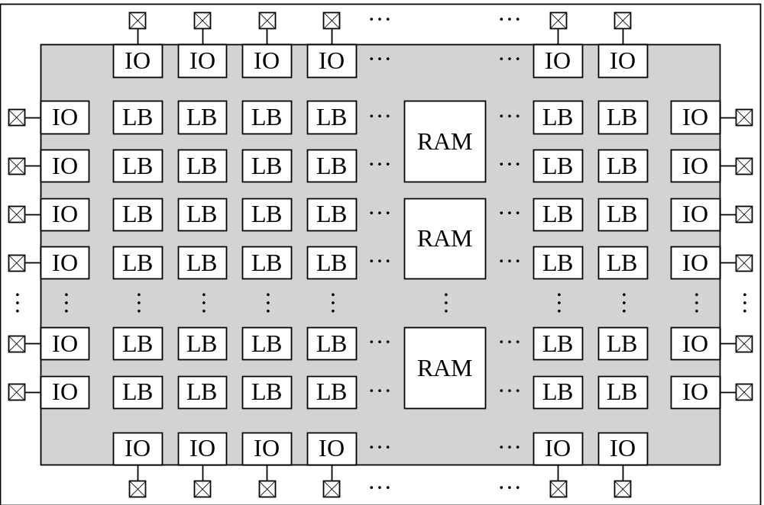
FPGAs
Field Programmable Gate Arrays
  Smaller logic blocks, embedded SRAM
  Thousands or millions of equivalent gates
Programmable interconnect

Slide 22
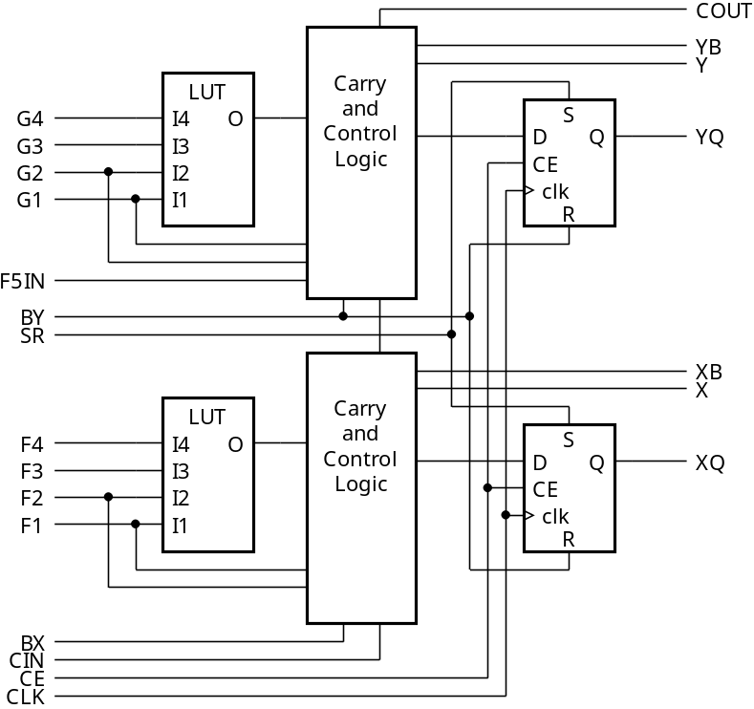
Logic Block Example
Xilinx FPGA Logic Blocks
  Lookup Tables (LUTs) plus flip-flops
  E.g., Spartan-II
Too complex to program LBs manually
  Let synthesis tools map HDL code to LBs and program the interconnect

Slide 23
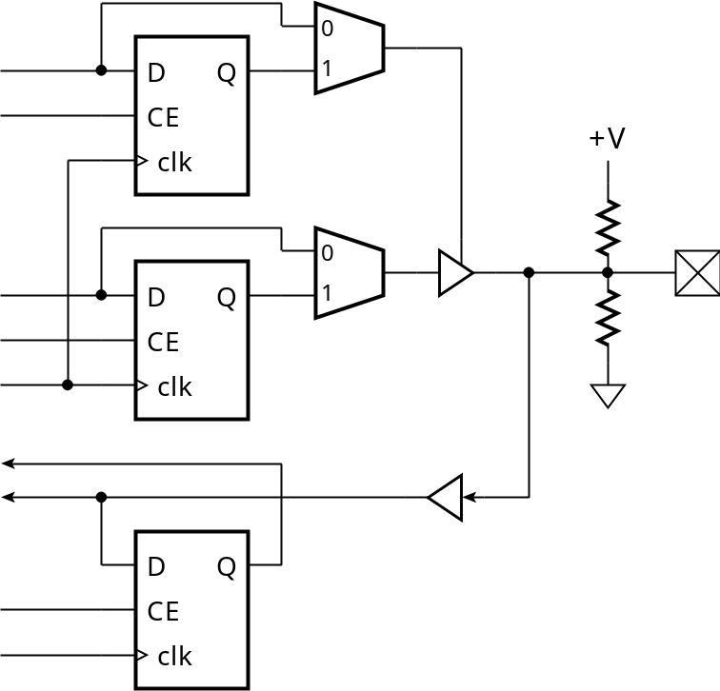
I/O Blocks
Typically allow for registered or combinational input/output, plus tristates
  Programmable logic levels, slew rate, input threshold, …

Slide 24
Platform FPGAs
Include embedded cores for special applications
  Processor cores
  Signal processing arithmetic cores
  Network interface cores
Embedded software can run from SRAM in the FPGA
  Single-chip solution, reduces cost
  Avoids high NRE of ASIC

Slide 25
Structured ASICs
Array of very simple logic elements
  Not programmable, no programmable interconnect
Customized by designing top metal interconnection layer(s)
  Lower NRE than full ASIC design
  Performance close to full ASIC
May become popular for mid-volume applications

Slide 26
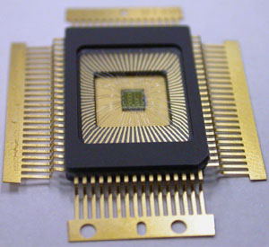
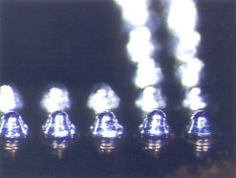
IC Packages
ICs are encapsulated in protective packages
  External pins for connected to circuit board
  Bond-wires or flip-chip connections

Slide 27
Printed Circuit Boards (PCBs)
Layers of conducting wires (copper) between insulating material (fiberglass)
  Manufactured using photolithography and etching
Wires interconnect ICs and other components
  External connections to other system components

Slide 28
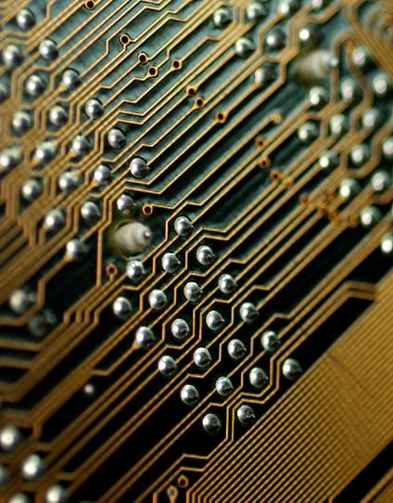
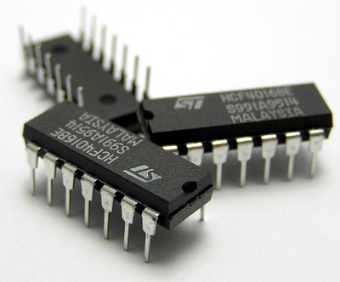
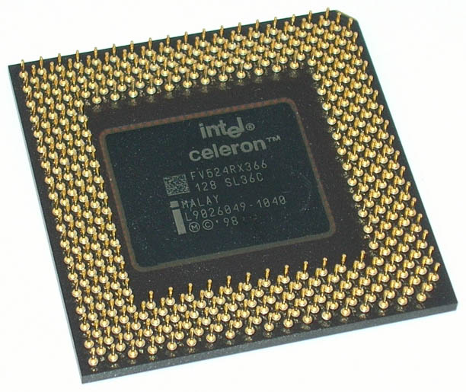
Through-Hole PCBs
IC package pins pass through drilled holes
  Soldered to PCB wires that join the hole

Slide 29
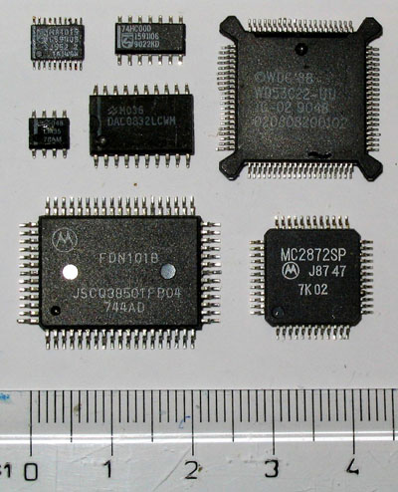
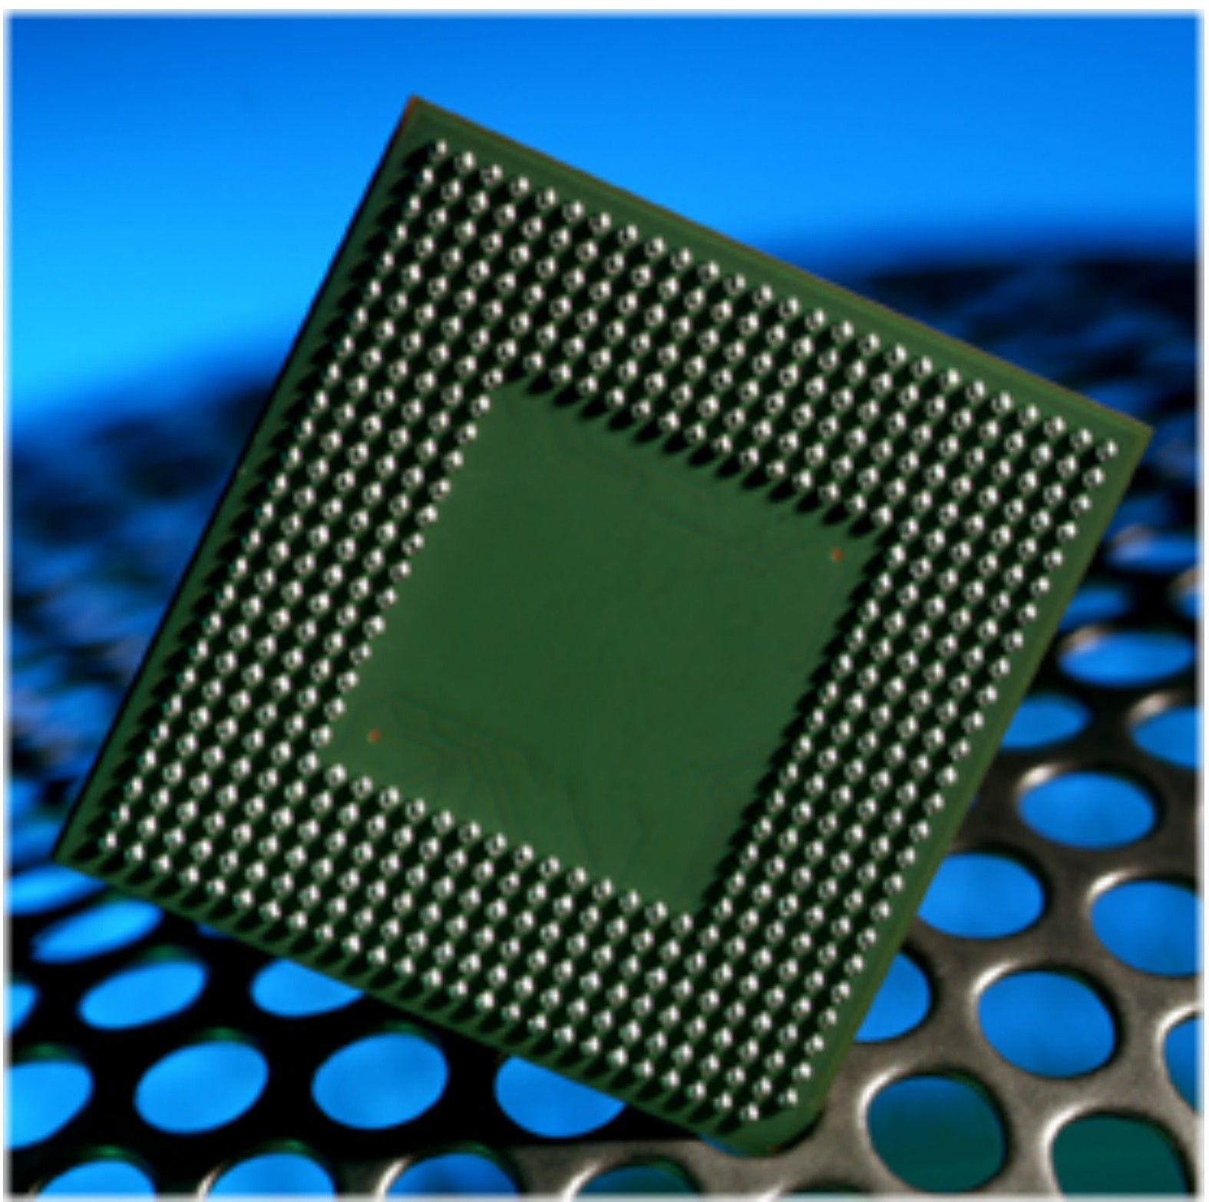
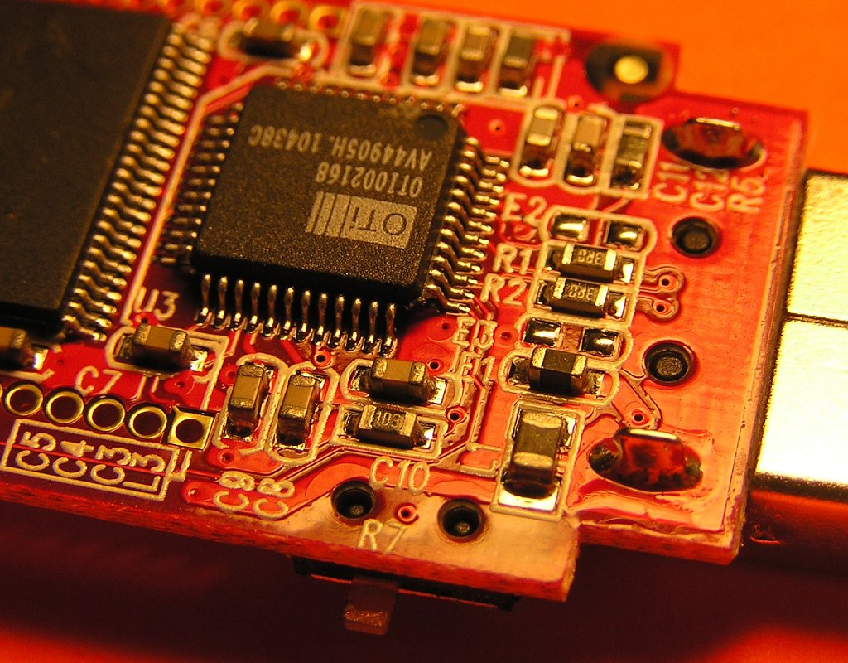
Surface Mount PCB
IC package pins soldered to wires on PCB surface
  Packages and PCB features are generally smaller than through-hole

Slide 30
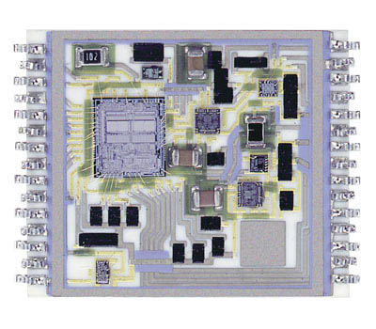
Multichip Modules (MCMs)
Several ICs on a ceramic carrier
  Can also include thin-film passives and discrete components
  External connections for PCB mounting
Ideal for high-density applications
  E.g., cell phones

Slide 31
Signal Integrity
Signals propagate over bond wires, package pins, PCB traces
  Various effects cause distortion and noise
  Signal integrity: minimizing these effects
Propagation delay in PCB trace
  ≈½c ⇒ ≈150mm/ns
If two traces differ in length
  Skew at arrival point can be significant
  Careful PCB design needed

Slide 32
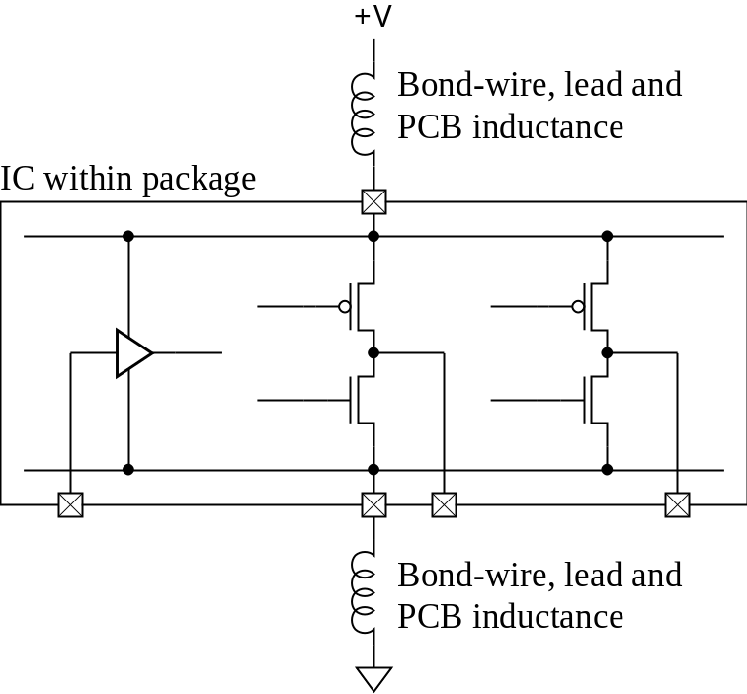
Ground Bounce
Transient current flows when an output switches logic level
  Parasitic inductance causes
  voltage shift on power supply
  & ground signals
  Spikes on other
  drivers
  Threshold shift on
  receivers

Slide 33
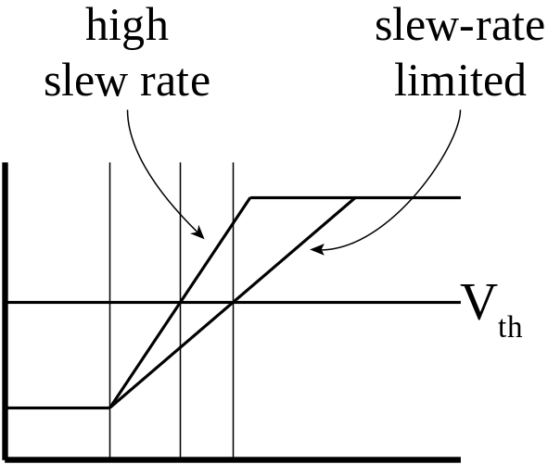
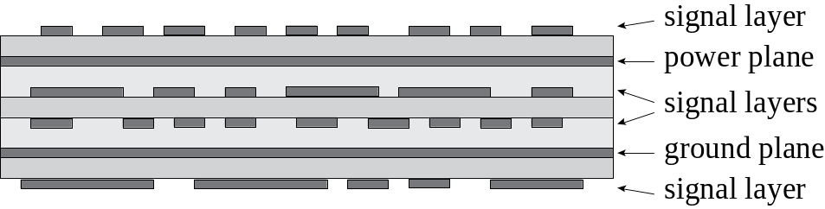
Minimizing Bounce
Bypass capacitors between ground and +V
  0.01µF – 0.1µF, close to package pins
Separate PCB planes for ground and +V
Limit output slew rate
  Trade off against
  propagation delay

Slide 34
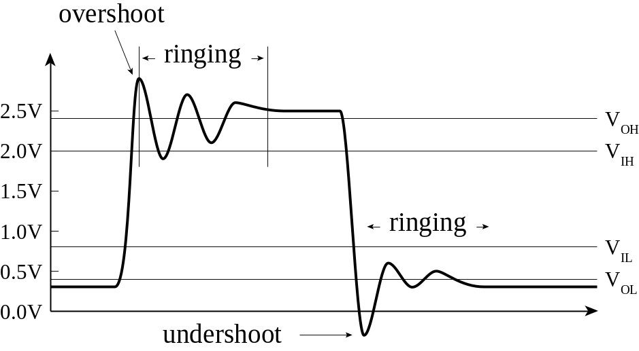
Transmission Line Effects
Occur when rise time is comparable to path delay
  Reflections interfere with transitions, resulting in under/overshoot and ringing
  Can cause false/multiple switching
  Use PCB layout
  techniques to
  minimize effects

Slide 35
Electromagnetic Interference
Transitions cause electromagnetic fields
  Energy radiated from PCB traces
  Induces noise in other systems
  Subject to regulation
Crosstalk
  Radiation to other traces in the system
    Particularly adjacent parallel traces
PCB layout and slew-rate limiting can minimize both

Slide 36
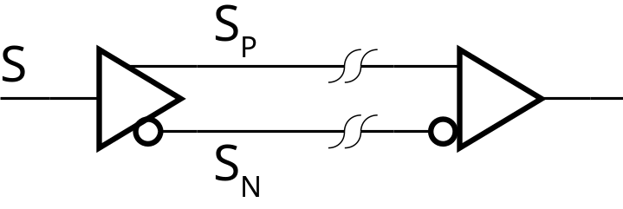
Differential Signaling
Reduces susceptibility to noise
Transmit a signal (S_{P}) and negation (S_{N})
  At receiver, sense difference between them
  S_{P} – S_{N}
Noise induced on both S_{P} and S_{N}
  (S_{P} + V_{Noise}) – (S_{N} + V_{Noise}) = S_{P} – S_{N}

Slide 37
Summary
Exponential improvements in IC manufacturing
SSI and MSI TTL logic families
ASICs: full-custom and standard cell
PALs, CPLDs, FPGAs, platform FPGAs
IC packages for PCB assembly
  Through-hole and surface mount
Signal integrity

